Slide 1
INTERTASK COMMUNICATION AND SYNCHRONIZATION
Nature of Tasks
- Normally all tasks are NOT independent
- All tasks can NOT be preempted at any point of execution
Task interaction is needed in most common applications and strictly controlled mechanisms are needed that allow tasks to
- communicate
share resources
synchronize activity
The main concern is minimize blocking that may arise in a uniprocessor system when concurrent tasks use shared resources
Task synchronization is required to maintain the consistency/integrity of the shared data/resources that can only be used by one task at a time.

Slide 2
1 Buffering Data
Global variables can be used to pass data between tasks in a multitasking system BUT tasks of higher priority can preempt lower-priority routines at inappropriate times, corrupting the global data.
Example:
One task may produce data at a constant 100 units per second, whereas another may consume these data at a rate less than 100 units per second.
Assuming that the production interval is finite (and relatively short), the slower consumption rate can be accommodated if the producer fills a storage buffer with the data.
The buffer holds the excess data until the consumer task can catch up.
The buffer can be a queue or other data structure, including an unorganized mass of variables.
Problem occurs if:
  consumer task consumes this information faster than it can be produced
  consumer cannot keep up with the producer
Selection of the appropriate size buffer is critical in reducing or eliminating these problems.

Slide 3
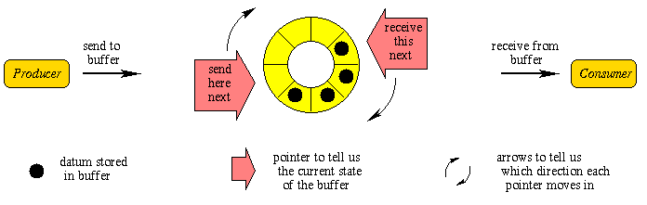
1 Buffering Data

Slide 4
2 Time-Relative Buffering
A common use of global variables is in double buffering or Ping-Pong buffering used when time-relative (correlated) data need to be transferred between cycles of different rates, or when a full set of data is needed by one process, but can only be supplied slowly by another process.
This situation is simply a variant of the classic bounded-buffer problem in which a block of memory is used as a repository for data produced by “writers” and consumed by “readers.”
A further generalization is the readers and writers problem in which there are multiple readers and multiple writers of a shared resource

Slide 5
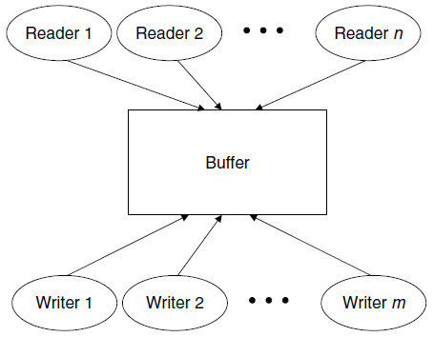
2 Time-Relative Buffering

Slide 6
2 Time-Relative Buffering
Systems that transmit blocks of data from one device to another, use double-buffering schemes with a hardware or software switch to alternate the buffers include:
Telemetry systems Disk controllers, Graphical interfaces,
Navigation equipment Robot controls
Example: Operator Display
In the operator display for the pasta sauce factory, suppose, lines are drawn on the screen one by one until the image is completed.
In an animated system, it is undesirable to see this drawing process.
If, however, the software draws on one screen image while displaying the other and then flips the screens when the new drawing is complete, the individual line drawing commands will not be seen
If the screens can be updated at about 30 screens per second, the operator’s display will appear fully animated.
Two identical buffers are filled and emptied by alternating tasks.
Switching is accomplished either by a software pointer or hardware discrete.

Slide 7
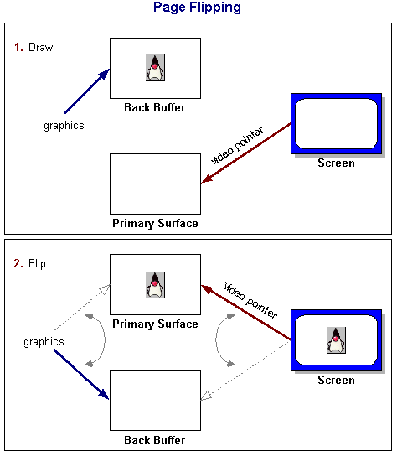
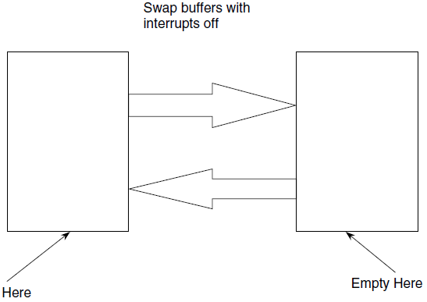
2 Time-Relative Buffering

Slide 8
Example: Inertial Measurement Unit.
It reads x, y, and z accelerometer pulses in a 10-millisecond cycle. These data are to be processed in a 40-millisecond cycle, which has lower priority than the 10-millisecond cycle (i.e., it can be preempted). The accelerometer data processed in the 40-millisecond cycle must be time-relative; that is, it is undesirable to process x and y accelerometer pulses from time t along with z accelerometer pulses from time t + 1. This scenario could occur if the 40-millisecond cycle has completed processing the x and y data, but gets interrupted by the 10-millisecond cycle.
To avoid this problem, use buffered variables xb, yb, and zb in the 40- millisecond cycle and buffer them, with interrupts disabled. The 40-millisecond routine might contain the following C code to handle the buffering:
  introf(); /* disable interrupts */
    xb=x; /* buffer data */
    yb=y;
    zb=z;
  intron(); /* enable interrupts */
  process(xb,yb,zb); /* use buffered data */
The first procedure in any cycle would be a buffering routine to buffer all data from tasks of higher priority into the current task (“buffer in” routine).
The last procedure in the cycle is a routine to buffer out data to any tasks of lower priority (“buffer out” routine).

Slide 9
3 Ring Buffers
A special data structure called a circular queue or ring buffer is used in the same way as a queue and can be used to solve the problem of synchronizing multiple reader and writer tasks.
Ring buffers are easier to manage than double buffers or queues when there are more than two readers or writers.
In the ring buffer, simultaneous input and output to the list are achieved by keeping head and tail indices.
Data are loaded at the tail and read from the head.
Suppose the ring buffer is a structure of type ring_buffer that includes an integer array of size of N called contents, namely,
    typedef struct ring_buffer
    {
      int contents[N];
      int head;
      int tail;
    }
Head and tail indices have been initialized to 0, that is, the start of the buffer

Slide 10
3 Ring Buffers
An implementation of the read(data,S) and write(data,S) operations, which reads from and writes to ring buffer S, respectively:
void read (int data, ring_buffer *s)
{
  if (s->head==s->tail)
    data=NULL; /* underflow */
  else{
    data=s->contents +head; /* retrieve data from buffer */
    s->head=(s->head+1) % N; /* decrement head index */
  }
}
void write (int data, ring_buffer *s)
{
  if ((s->tail+1) %N==head)
    error(); /* overflow, invoke error handler */
  else{
    s->contents+tail=data;
    tail=(tail+1) % N; /*take care of wrap-around */
  }
}

Slide 11
3 Ring Buffers
Task using the ring buffer also needs to test the data for the
Underflow (NULL) value.
  Underflow is the condition when a task attempts to retrieve data from an empty buffer.
Overflow
  An overflow occurs when an attempt is made to write data to a full queue.
  Ring buffers can be used in conjunction with a counting or binary semaphore to control multiple requests for a single resource such as memory blocks, modems, and printers.

Slide 12
Mailboxes
Difference between pend operation and polling the mailbox:
Pending task is suspended while waiting for data to appear, no time is wasted continually checking the mailbox so the busy waiting condition is eliminated
Mailbox Implementation
Mailboxes are best implemented in systems based on the task control block model with a supervisor task.
A table containing a list of tasks and needed resources (e.g., mailboxes, printers, etc.) is kept along with a second table containing a list of resources and their states.
Mailboxes or message exchanges are an intertask communication device available in many commercial, full-featured operating systems.
A mailbox is a mutually agreed upon memory location that one or more tasks can use to pass data and for synchronization.

Slide 13
Mailboxes
The tasks rely on the kernel to allow them to write to the location via a post operation or to read from it via a pend operation
Implementation of mailbox operations pend and post:
  void pend (int data, s){
  data gets contents of mailbox S if any, suspend task otherwise
  }
  void post (int data, s){
  mailbox S gets data
  }
The datum that is passed can be a flag used to protect a critical resource (called a key), a single piece of data, or a pointer to a data structure.
In most implementations, when the key is taken from the mailbox, the mailbox is emptied.
Although several tasks can pend on the same mailbox, only one task can receive the key.
Since the key represents access to a critical resource, simultaneous access is precluded.

Slide 14
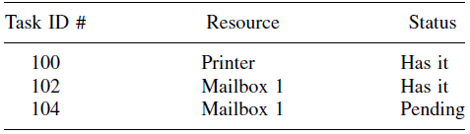
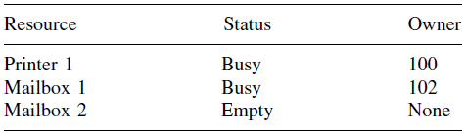
Mailboxes

Slide 15
5 Queues
Some operating systems support a type of mailbox that can queue multiple pend requests.
These systems provide qpost, qpend, and qaccept operations to post, pend, and accept a data to/from the queue. In this case, the queue can be regarded as any array of mailboxes, and its implementation is facilitated through the same resource tables
Queues should not be used to pass arrays of data; pointers should be used instead.
Queues are useful in implementing device servers where a pool of devices is involved.
Here the ring buffer holds requests for a device, and queues can be used at both the head and the tail to control access to the ring buffer, useful in the construction of device-controlling software.

Slide 16
6 Critical Regions
Multitasking systems are concerned with resource sharing, these resources can only be used by one task at a time, and use of resource cannot be interrupted as they are serially reusable like peripherals, shared memory, CPU.
CPU protects itself against simultaneous use but the code (critical region) that interacts with the other serially reusable resources cannot
If two tasks enter the same critical region simultaneously, a catastrophic error can occur.
Two C programs, Task_A and Task_B, which are running in a roundrobin system:
Task_B outputs the message “I am task_B” and Task_A outputs the message “I am Task_A.”
In the midst of printing, Task_B is interrupted by Task_A, which begins printing.
The result is the incorrect output:
I am I am Task_A Task_B
The emphasis is placed on the middle text to show that it interrupted the output of the Task_B.
Serious complications could arise if both tasks were controlling devices in an embedded system. Simultaneous use of a serial reusable resource results in a collision.

Slide 17
7 Semaphores
The most common method for protecting critical regions involves a special variable called a semaphore.
A semaphore S is a memory location that acts as a lock to protect critical regions.
Two operations, wait and signal are used either to set or to reset the semaphore.
Traditionally, one denotes the wait operation as P(S) and the signal operations V(S)
The primitive operations are defined by the following C code:
The wait operation suspends any program calling until the semaphore S is FALSE, whereas the signal operation sets the semaphore S to FALSE.
Code that enters a critical region is bracketed by calls to wait and signal.
This prevents more than one process from entering the critical region.
C passes by value unless forced to pass by reference by passing a pointer; so, when calling functions the dereferencing operator “&” should be used.
However, for convenience of notation, when a parameter is passed, it is as if the address of the parameter is passed to the function. Alternatively, the parameter can be viewed as a global variable.

Slide 18
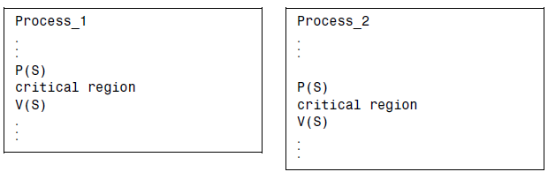
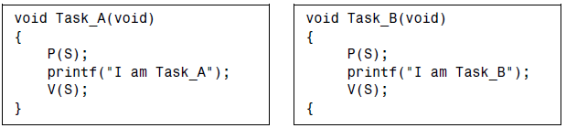
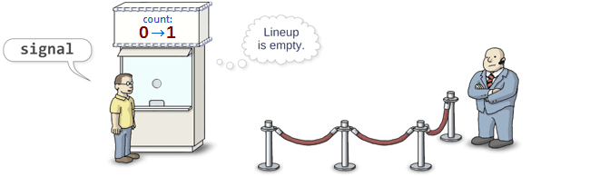
7 Semaphores

Slide 19
a. Mailboxes
Mailboxes can be used to implement semaphores if semaphore primitives are not provided by the operating system.
In this case, there is the added advantage that the pend instruction suspends the waiting process rather than actually waiting for the semaphore.
For example, using the dummy data, KEY, the operations are implemented as follows
The accompanying signal operation utilizes the mailbox post operation.

Slide 20
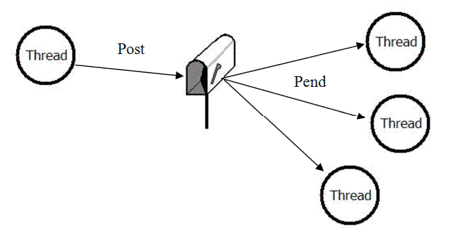
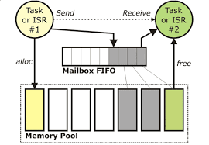
a. Mailboxes

Slide 21
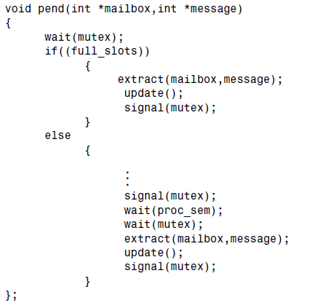
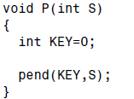
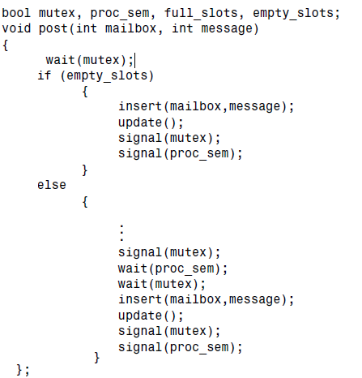
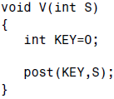
a. Mailboxes

Slide 22
b. Counting Semaphores
The P and V semaphores are called binary semaphores because they can take one of two values. Alternatively, a counting semaphore or general semaphore can be used to protect pools of resources, or to keep track of the number of free resources.
The semaphore must be initialized to the total number of free resources before real-time processing can commence.
The new wait and signal semaphore primitives, MP and MV, are designed to present access to a semaphore-protected region when the semaphore is less than or equal to zero.
The semaphore is released or signaled by incrementing it.

Slide 23
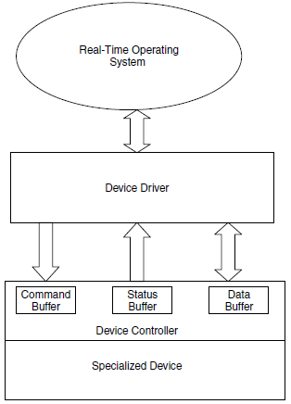
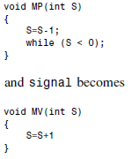
b. Counting Semaphores

Slide 24
b. Counting Semaphores
Some real-time kernels provide only binary semaphores, but the counting semaphore can be simulated with binary semaphores in the following way. Suppose S and T are binary semaphores and P(S) and V(S) are the
wait and signal operations, respectively, on binary semaphores. The counting semaphore operations
MP(R) and MV(R) can be created on multiple semaphores R using global binary semaphores S and T and integer R as follows:

Slide 25
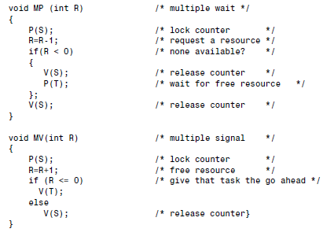
b. Counting Semaphores

Slide 26
c. Problems with Semaphores
Certain problems arise if the operation of testing and subsequent setting of a semaphore are not atomic or
uninterruptible.
Suppose two tasks in a round-robin system with time slicing are using a resource protected by a binary semaphore S.
where “1” is TRUE and “0” is FALSE. Suppose the process using the semaphore primitive were interrupted between the TEST and STORE instructions.
The interrupting routine, which might use the same resource, finds S to be available and begins using it.
If this task then suspends (its time slice ran out) and the interrupted task resumes, it will still see the device as free because the old contents of S are still in register 1.
Thus, two tasks attempt to use the same resource and a collision occurs.
This problem may occur infrequently, and so it may be difficult to test and detect.

Slide 27
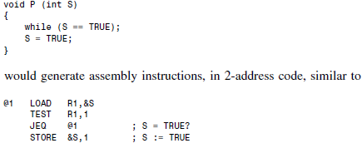
c. Problems with Semaphores

Slide 28
d. The Test-and-Set Instruction
To solve the problem of atomic operation between testing a memory location and storing a specific value in it, most instruction sets provide a test-and-set macroinstruction.
The instruction fetches a word from memory and tests the high-order (or other) bit.
If the bit is 0, it is set to 1 and stored again, and a condition code of 0 is returned.
If the bit is 1, a condition code of 1 is returned and no store is performed.
The fetch, test, and store are indivisible.
The wait and signal operations can be implemented easily with a test-and-set instruction.

Slide 29
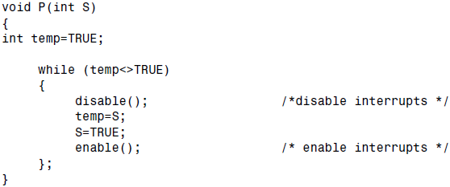
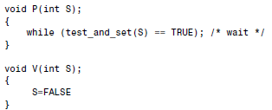

d. The Test-and-Set Instruction

Slide 30
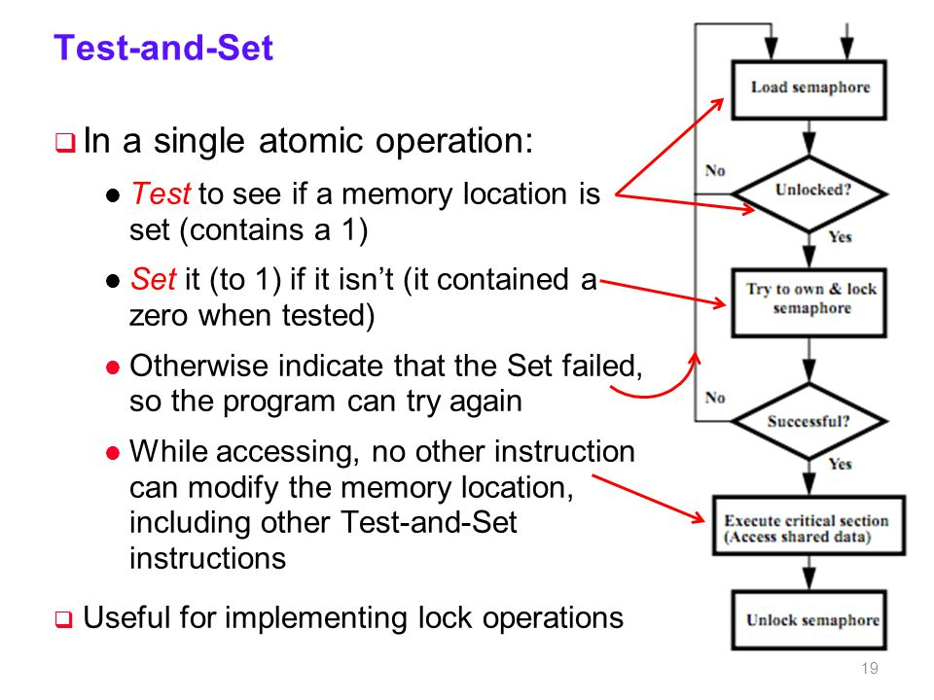
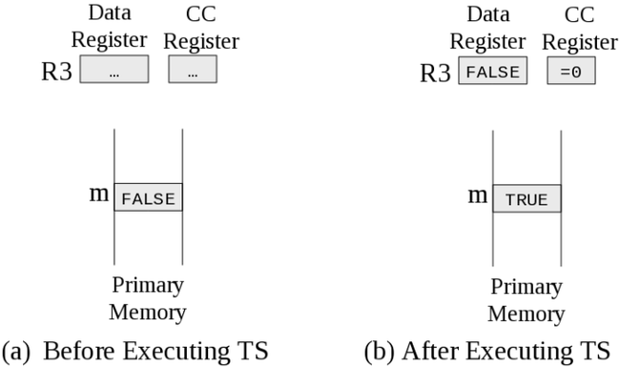

Slide 31
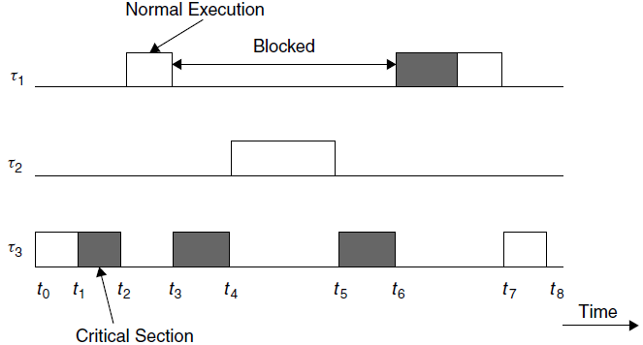
Priority Inversion
When a low-priority task blocks a higher-priority one, a priority inversion is said to occur.

Slide 32
Priority Inversion
When a low-priority task blocks a higher-priority one, a priority inversion is said to occur.

Slide 33
Resource Conflicts and Blocking:
Three jobs J₁ ( 6,14 ], J₂( 2,17 ], J₃ (0 ,18]
The jobs are scheduled on the processor on the EDF basis
J₁ has the highest and J₃ has the lowest priority
All three jobs require the resource R which has only one unit
The critical sections in these jobs are [R;2], [R;4],[R;4] respectively
0 2 4 6 8 10 12 14 16 18 20
J₁
J₂ can’t use R
J₃

Slide 34
0 2 4 6 8 10 12 14 16 18 20
J₁
J₂
J₃
0 2 4 6 8 10 12 14 16 18 20
J₁
J₂
J₃
Uncontrolled Priority Inversion

Slide 35
The Priority Inheritance Protocol
Priority Inheritance Protocol, offers a simple solution to the problem of unbounded priority inversion.
In the Priority Inheritance Protocol the priority of tasks are dynamically changed so that the priority of any task in a critical region gets the priority of the highest task pending on that same critical region.
When a task, τ_{i}, blocks one or more higher-priority tasks, it temporarily inherits the highest priority of the blocked tasks.

Slide 36
The highlights of the protocol are:
The highest-priority task, τ , relinquishes the processor whenever it seeks to lock the semaphore guarding a critical section that is already locked by some other job.
If a task, τ₁, is blocked by τ₂ and τ₁ > τ₂, (i.e., τ₁ has precedence over τ₂), task τ₂ inherits the priority of τ₁ as long as it blocks τ₁. When τ₂ exits the critical section that caused the block, it reverts to the priority it had when it entered that section.

Slide 37
Highlights of the Protocol:
Priority inheritance is transitive. If τ₃ blocks τ₂, which blocks τ₁ (with τ₁ > τ₂ > τ₃), then τ₃ inherits the priority of τ₁ via τ₂.
Show with a timeline!!!
It is important to point out that the Priority Inheritance Protocol does not prevent deadlock.

Slide 38
Highlights of the Protocol:
The highest-priority task, τ , relinquishes the processor whenever it seeks to lock the semaphore guarding a critical section that is already locked by some other job.
If a task, τ₁, is blocked by τ₂ and τ₁ > τ₂, (i.e., τ1 has precedence over τ2), task τ₂ inherits the priority of τ1 as long as it blocks τ₁. When τ₂ exits the critical section that caused the block, it reverts to the priority it had when it entered that section.
Priority inheritance is transitive. If τ₃ blocks τ₂, which blocks τ₁ (with τ₁ > τ₂ > τ₃), then τ₃ inherits the priority of τ₁ via τ₂.
It is important to point out that the Priority Inheritance Protocol does not prevent deadlock.

Slide 39
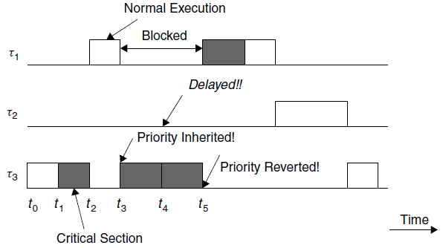
Highlights of the Protocol:

Slide 40
The priority ceiling of the black resource is two as J₂ is the highest priority job among the jobs requiring it
The priority ceiling of the shaded resource is one
0 2 4 6 8 10 12 14 16 18 20
Fails
J₁
Fails
J₂
J₃
Fails
J₄
J₅
Schedule under Priority Inheritance

Slide 41


NASA’s Mars Pathfinder Space Mission and Priority Inversion

Slide 42
NASA’s Mars Pathfinder Space Mission and Priority Inversion
A notorious incident of the priority inversion problem occurred in 1997 in NASA’s Mars Pathfinder Space mission’s Sojourner rover vehicle, which was used to explore the surface of Mars.
In this case the Mil-std-1553B information bus manager was synchronized with mutexes.
Accordingly a meteorological data-gathering task that was of low priority and low frequency blocked a communications task that was of higher priority and higher frequency.
This infrequent scenario caused the system to reset.
The problem would have been avoided if the priority inheritance mechanism provided by the commercial real-time operating system had been used. But it had been disabled.
Fortunately, the problem was diagnosed in ground-based testing and remotely corrected by reenabling the priority inheritance mechanism.

Slide 43
Priority Ceiling Protocol
The Priority Ceiling Protocol extends to the Priority Inheritance Protocol through chained blocking in such a way that no task can enter a critical section in a way that leads to blocking it.
To achieve this, each resource is assigned a priority (the priority ceiling) equal to the priority of the highest priority task that can use it.
The Priority Ceiling Protocol is the same as the Priority Inheritance Protocol, except that a task, T , can also be blocked from entering a critical section if there exists any semaphore currently held by some other task whose priority ceiling is greater than or equal to the priority of T .

Slide 44
Priority Ceiling Protocol : Current Priority Ceiling of System
At any time t , the current priority ceiling of the system is equal to the highest priority ceiling of the resources that are in use at that time, if some resources are in use
If all the resources are free at the time, the current ceiling Π (t) is Ω, a non existing priority level that is lower than the lowest priority of all jobs

Slide 45
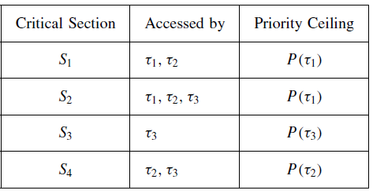
Priority Ceiling Protocol
Suppose that τ₂ currently holds a lock on S₂, and τ₁ is initiated. Task τ₁ will be blocked from entering S₁ because its priority is not greater than the priority ceiling of S₂.

Slide 46
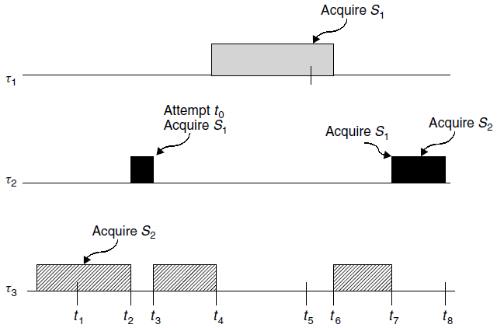
Priority Ceiling Protocol
τ₁: Lock S₁; Unlock S₁
τ₂: Lock S₁; Lock S₂; Unlock S₂; Unlock S₁
τ₃: Lock S₂; Unlock S₂
Following the rules of assigning priority ceiling to semaphores, the priority ceilings of S₁ and S₂ are P(τ₁) and P(τ₂), respectively.

Slide 47
[0,1) current ceiling of the system is Ω lower than 5
In (1,3] interval black is held by J₅ so the current ceiling of the system is 2
In (3,13] interval when shaded is also in use the current ceiling of the system is 1
0 2 4 6 8 10 12 14 16 18 20
J₁
J₂
J₃
J₄
J₅
Schedule under Priority Ceiling

Slide 48
Difference between Priority Inheritance and Priority Ceiling Protocols
0 2 4 6 8 10 12 14 16 18 20
0 2 4 6 8 10 12 14 16 18 20
J₁
J₁
J₂
J₂
J₃
J₃
J₄
J₄
J₅
Schedule under Priority Ceiling Protocol
J₅
Schedule under Priority Inheritance
1
2
3
4

Slide 49

Basic Results of Resource Access Protocols
A task can be blocked by a lower-priority task only once, and at most the duration of one critical section.
The following is a sufficient condition to test for feasibility of RM scheduling of n periodic tasks under all task phasings:
where B_{i} is the blocking time that task τ_{i} can experience from a lower-priority task and p_{i} is the period of task τ_{i}

Slide 50
Basic Results of Resource Access Protocols
Deadlock avoidance:
The set of priority ceiling of resources impose a linear order on all the resources, so deadlock can never occur under priority ceiling protocol
Similarity:
The priority inheritance rules of these two protocols are the same
Both rules say that whenever a lower priority job J_{l} blocks the job J whose request is just denied, the priority of J_{l} is raised to J’s priority π(t)
Difference arises because of the non-greedy nature of the priority ceiling protocol

Slide 51
MEMORY MANAGEMENT
Dynamic memory allocation, is important in terms of both the use of on-demand memory by applications tasks and the requirements of the operating system.
Applications tasks use memory explicitly through requests for heap memory, and implicitly through the maintenance of the run-time memory needed to support sophisticated high-order languages.
The operating system needs to perform extensive memory management in order to keep the tasks isolated.

Slide 52
MEMORY MANAGEMENT
Dangerous allocation of memory is any allocation that can stop system determinism destroy event determinism overflowing the stack, destroy temporal determinism by causing a deadlock situation.
It is important to avoid dangerous allocation of memory while at the same time reducing the overhead incurred by memory allocation.
This overhead is a standard component of the context switch time and must be minimized.

Slide 53
1 Process Stack Management
In a multitasking system, context for each task needs to be saved and restored in order to switch processes.
This can be done by using one or more run-time stacks or the task-control block model.
Run-time stacks work best for interrupt only systems and foreground/background systems, whereas the task-control block model works best with full-featured real-time operating systems.

Slide 54
1.1 Managing the Stack
If a run-time stack is to be used to handle the run-time saving and restoring of context, two simple routines – save and restore – are necessary.
The save routine is called by an interrupt handler to save the current context of the machine into a stack area.
To present disaster, this call should be made immediately after interrupts have been disabled.
The restore routine should be called just before interrupts are enabled and before returning from the interrupt handler.

Slide 55
Example: Implementation of Save Routine
Assume the global variable stack is to point to the top of the stack and that eight general registers (R0–R7) are to be saved on a stack.
The memory location “PC” corresponds to the interrupt return vector location, and so it contains the program counter value at the time of interruption.
It is necessary to save this on the stack to allow stacking of interrupts.
The pseudocode for a 2-address architecture works by saving a pointer to the top of the stack and uses an “indirect: mode represented by “,I” to sequentially store the other registers.

Slide 56
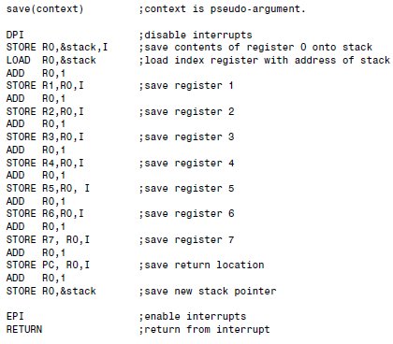
Example: Implementation of Save Routine

Slide 57
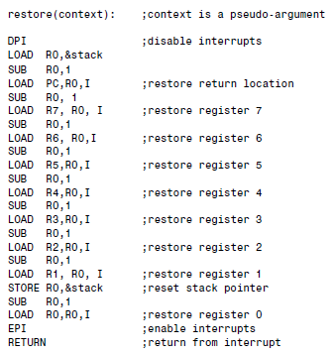
Example: Implementation of Restore Routine

Slide 58
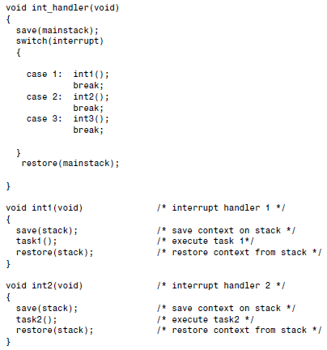
Interrupt–handler routines to save to a Main Stack

Slide 59
Example
Three processes, task1, task2, and task3, are running in an interrupt-only system where a signal interrupt based on three prioritized interrupts is generated.
Suppose task1 is running when it is interrupted by task2. Later task2 is interrupted by task3.
The run-time stack evolves as interruptions take place
Certain machine architectures allow block save and block restore instructions to store and load n general registers in n consecutive memory locations.
These instructions greatly simplify the implementation of the save and restore routines.
Such macroinstructions may be designed to be interruptible (to reduce context switch time), so that if interrupts have not already been disabled, they should be.

Slide 60
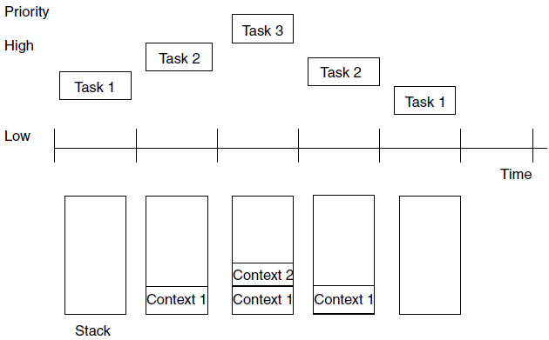
Example

Slide 61
1.2 Task-Control Block Model
If the task-control block model is used, then a list of either fixed or dynamic task-control blocks is kept.
Fixed case
n task-control blocks are allocated at system generation time, all in the dormant state.
As tasks are created, the task-control block enters the ready state.
Prioritization or time slicing will then move the task to the execute state.
If a task is to be deleted, its task-control block is simply placed in the dormant state.
In the case of a fixed number of task-control blocks, no real-time memory management is necessary.

Slide 62
1.2 Task-Control Block Model
Dynamic case
task-control blocks are added to a linked list or some other dynamic data structure as tasks are created.
The tasks are in the suspended state upon creation and enter the ready state via an operating system call or event.
The tasks enter the execute state owing to priority or time slicing.
When a task is deleted, its task-control block is removed from the linked list, and its heap memory allocation is returned to the unoccupied or available status.
Real-time memory management consists of managing the heap needed to supply the task-control blocks; however, other data structures such as a list or sequence can be used.

Slide 63
2 Run-Time Ring Buffer
A run-time stack cannot be used in a round-robin system because of the first-in, first-out (FIFO) nature of the scheduling.
In this case a ring buffer or circular queue can be used to save context.
The context is saved to the tail of the list and restored from the list and restored from the head. The save and restore routines can be easily modified to accomplish this operation.

Slide 64
3 Maximum Stack Size
The maximum amount of space needed for the run-time stack needs to be known a priori.
In general stack size can be determined if recursion is not used and heap data structures are avoided.
If maximum stack memory requirements are not known, then a catastrophic memory allocation can occur, and the system will fail to satisfy event determinism.
Ideally, provision for at least one more task than anticipated should be allocated to the stack to allow for spurious interrupts and time overloading.

Slide 65
4 Multiple-Stack Arrangements
Often a single run-time stack is inadequate to manage several processes in, say, a foreground/background system.
A multiple-stack scheme uses a single run-time stack and several application stacks.
Advantages of using multiple stacks in embedded real-time systems:
It permits tasks to interrupt themselves, thus allowing for handling transient overload conditions or for detecting spurious interrupts.
The system can be written in a language that supports reentrancy and recursion, such as C or Ada.
Individual run-time stacks can be kept for each process, which contains the appropriate activation records with dynamic links needed to support recursion. Or two stacks for each process can be kept, one for the activation records and the other for the display (a stack of pointers used to keep track of variable and procedure scope).
In either case, a pointer to these stacks needs to be saved in the context or task-control block associated with that task.

Slide 66
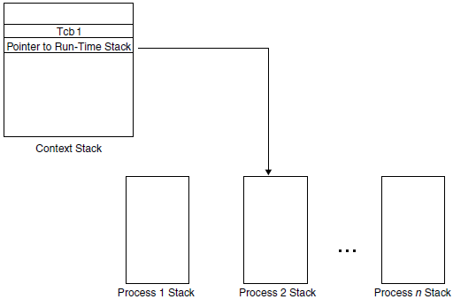
4 Multiple-Stack Arrangements

Slide 67
5 Memory Management in Task-Control-Block Model
When implementing the TCB model of real-time multitasking, the chief memory management issue is the maintenance of the linked lists for the ready and suspended tasks.
When the currently executing task completes, is preempted, or is suspended while waiting for a resource, the next highest priority task in the ready list is removed and is made the executing one.

Slide 68
5 Memory Management in Task-Control-Block Model
If the executing task needs to be added to the suspended list, that is done. (If the executing task has completed, then its TCB is no longer needed.)
By properly managing the linked lists, updating the status word in the TCBs, and adhering to the appropriate scheduling policy by checking the priority word in the TCBs, round-robin, preemptive priority, or both kinds of scheduling can be induced.

Slide 69
5 Memory Management in Task-Control-Block Model
Other memory management can include the maintenance of several blocks of memory that are allocated to individual applications as requested.
An alternative to multiple lists involves a single list in which only the status variable in the TCB is modified rather than moving the block.

Slide 70
5 Memory Management in Task-Control-Block Model
For example, when a task is moved from suspended to ready state, or from the ready to executing state, only the status word is changed.
This approach has the advantage of less list management but slower traversal times, since the entire list must be traversed during each context switch to identify the next highest priority task that is ready to run.

Slide 71
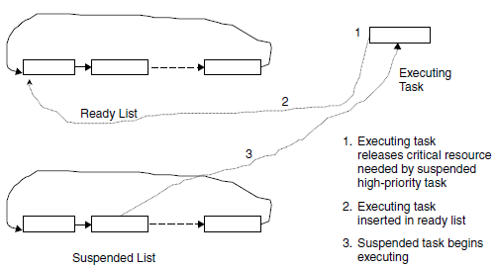
5 Memory Management in Task-Control-Block Model

Slide 72
6 Swapping
The simplest scheme that allows the operating system to allocate memory to two processes “simultaneously” is swapping.
In this case, the operating system is always memory resident, and one process can coreside in the memory space not required by the operating system, called the user space.
When a second process needs to run, the first process is suspended and then swapped, along with its context, to a secondary storage device, usually a disk.

Slide 73
6 Swapping
The second process, along with its context, is then loaded into the user space and initiated by the dispatcher.
This type of scheme can be used along with round-robin or preemptive priority systems, but it is desirable to have the execution time of each process to be long relative to the swap time.
The access time to the secondary store is the principal contributor to the context switch overhead and real-time response delays.

Slide 74
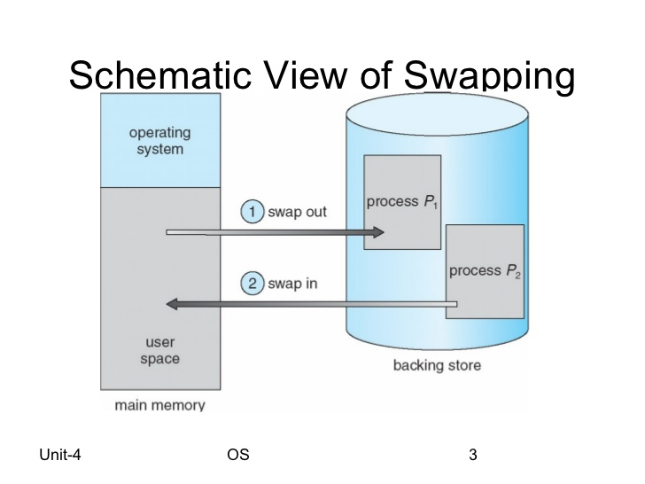
6 Swapping

Slide 75
7 Overlays
Overlaying is a simple technique that allows a single program to be larger than the allowable memory.
In this case the program is broken up into dependent code and data sections called overlays, which can fit into available memory.
Special program code must be included that permits new overlays to be swapped into memory as needed (over the existing overlays), and care must be exercised in the design of such systems.
This technique has negative real-time implications because the overlays must be swapped from secondary storage devices.
Overlaying can be used to extend the available address space.
Some commercial real-time operating systems support overlaying in conjunction with commonly used programming languages and machines.
In both swapping and overlaying a portion of memory that contains the swap or overlays manager, is never swapped to disk or overlaid.

Slide 76
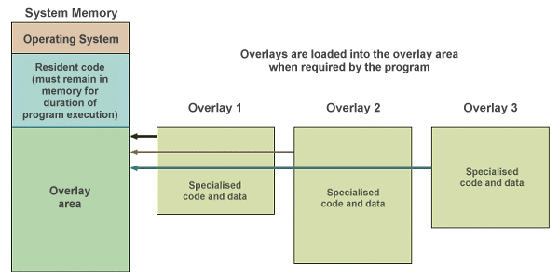
7 Overlays

Slide 77
8 Block or Page Management
Allows more than one process to be memory-resident at any one time by dividing the user space into a number of fixed-size partitions.
This scheme is useful in systems where the number of tasks to be executed is known and fixed, as in many embedded applications.
Partition swapping to disk can occur when a task is preempted.
Tasks, however, must reside in continuous partitions, and the dynamic allocation and deallocation of memory can cause problems.

Slide 78
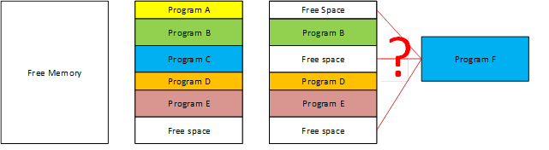
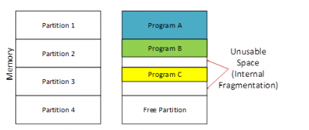
8 Block or Page Management

Slide 79
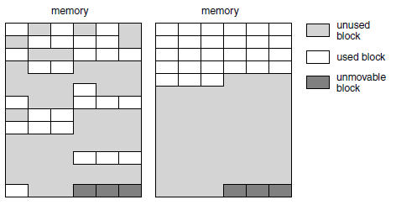
8 Block or Page Management

Slide 80
Fragmentation:
External fragmentation
In some cases main memory can become checkered with unused but available partitions
This type of fragmentation causes problems when memory requests cannot be satisfied because a contiguous block of the size requested does not exist, even though the actual memory is available.
Internal fragmentation
Occurs in fixed-partition schemes when, for example, a process requires 1 megabyte of memory when only 2- megabyte partitions are available.
The amount of wasted memory or internal fragmentation can be reduced by creating fixed partitions of several sizes and then allocating the smallest partition greater than the required amount.
Both memory internal and external fragmentation hamper efficient memory usage and ultimately degrade real-time performance because of the overhead associated with their correction.
This type of dynamic memory allocation uses memory inefficiently as a result of the overhead associated with fitting a process to available memory and disk swapping.

Slide 81
Fragmentation:
In commercial realtime executives, memory can be divided into regions in which each region contains a collection of different-sized, fixed-sized partitions. For example, one region of memory might consist of 10 blocks of size 16 Mb, while another region might contain 5 blocks of 32 Mb, and so on.
The operating system then tries to satisfy a memory request (either directly from the program via a system call or through the operating system in the assignment of that process to memory),so that the smallest available partitions are used. This approach tends to reduce internal fragmentation.
In an alternative scheme, memory is allocated in amounts that are not fixed, but rather are determined by the requirements of the process to be loaded into memory.
This technique is more appropriate when the number of real-time tasks is unknown or varies.
In addition, memory utilization is better for this technique than for fixed-block schemes because little or no internal fragmentation can occur, as the memory is allocated in the amount needed for each process.

Slide 82
External Fragmentation:
Compressing fragmented memory or compaction can be used to mitigate internal fragmentation Compaction is a CPU-intensive process and is not encouraged in hard real-time systems. If compaction must be performed, it should be done in the background, and it is imperative that interrupts be disabled while memory is being shuffled.
In demand page systems, program segments are permitted to be loaded in noncontiguous memory as they are requested in fixed-size chunks called pages.
This scheme helps to eliminate external fragmentation. Program code that is not held in main memory is “swapped” to secondary storage, usually a disk.
When a memory reference is made to a location within a page not loaded in main memory, a page fault exception is raised.
The interrupt handler for this exception checks for a free page slot in memory. If none is found, a page block must be selected and swapped to disk (if it has been altered), a process called page stealing.
Paging, which is provided by most commercial operating systems, is advantageous because it allows nonconsecutive references to pages via a page table.

Slide 83
External Fragmentation:
In addition, paging can be used in conjunction with bank-switching hardware to extend the virtual address space. In either case, pointers are used to access the desired page.
These pointers may represent memory-mapped locations to map into the desired hard-wired memory bank, may be implemented through associative memory, or may be simple offsets into memory, in which case the actual address in main memory needs to be calculated with each memory reference.
Paging can lead to problems, including very high paging activity called thrashing, internal fragmentation, and the more serious deadlock. But it is unlikely that a system would use so complex a scheme as paging in an embedded real-time system, where the overhead would be too great and the associated hardware support is not usually available.

Slide 84
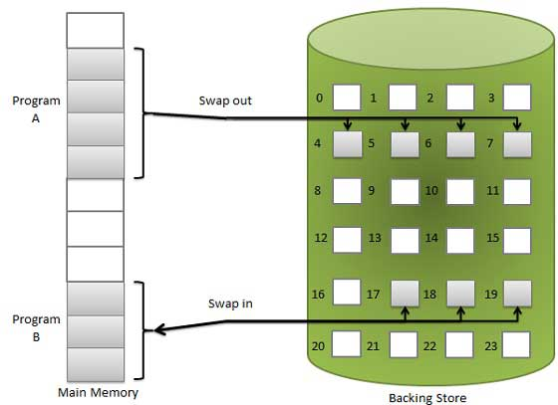

Slide 85


Slide 86
10 Memory Locking
The main disadvantage of page swapping in real-time systems is thrashing and lack of predictable execution times
In a real-time system, it is often desirable to lock all or a certain part of a process into memory to reduce overhead involved in paging and to make execution times more predictable.
Commercial real-time kernels provide this feature, called memory locking that allow code or data segments, or both, for a particular process, as well as the run-time stack segment, to be locked into main memory.
Any process with one or more locked pages is then prevented from being swapped out to disk.
Memory locking decreases execution times for the locked modules and, more importantly, can be used to guarantee execution times.
At the same time, it makes fewer pages available for the application, encouraging contention.

Slide 87
11 Working Sets
Working sets are based on the model of locality-of-reference.
The idea is if a list of recently executed program instructions is observed on a logic analyzer, it can be noted that most of the instructions are localized to within a small number of instructions in most cases.
In the absence of interrupts and branching, the program is executed sequentially, or the body of a loop may be executed a large number of times.
When interrupts, procedure calls, or branching occurs, the locality-of-reference is altered.

Slide 88
11 Working Sets
The idea in working sets is that a set of local-code windows is maintained in the cache and that upon accessing a memory location not contained in one of the working sets, one of the windows in the working set is replaced using a replacement rule such as FIFO or LRU.
The performance of the scheme is based on:
- size of the working-set window
- number of windows in the working set
locality-of-reference of the code being executed.

Slide 89
11 Working Sets
Conceptual model proposed by Peter Denning to prevent thrashing.
The collection of pages a process is using actively, and which must thus be memory-resident to prevent this process from thrashing.
If the sum of all working sets of all runnable threads exceeds the size of memory, then stop running some of the threads for a while.
Divide processes into two groups: active and inactive:
When a process is active its entire working set must always be in memory: never execute a thread whose working set is not resident
When a process becomes inactive, its working set can migrate to disk.
Threads from inactive processes are never scheduled for execution.

Slide 90
12 Real-Time Garbage Collection
Garbage is memory that has been allocated but is no longer being used by a task or abandoned by the task.
Garbage can accumulate when processes terminate abnormally without releasing memory resources.
In C if memory is allocated using the malloc procedure and the pointer for that memory block is lost, then that block cannot be used or properly freed.
Garbage can also develop in object-oriented systems and as a normal byproduct of non-procedural languages such as C++.
Real-time garbage collection is an important function that must be performed either by the language’s run-time support (e.g., in Java) or by the operating system where garbage collection is not part of the language.

Slide 91
13 Contiguous File Systems
Disk I/O is a problem in many real-time systems that can be worsened by file fragmentation.
In addition to the logical overhead incurred in finding the next allocation unit in the file, the physical overhead of the disk mechanism is a factor.
For example, physical overhead involved in moving the disk’s read/write head to the desired sector can be significant.
To reduce or eliminate this problem, many commercial real-time systems, such as real-time UNIX, force all allocated sectors to follow one another on the disk, a technique called contiguous file allocation.

